Slide 1
For deployment yaml file via Kubernetes service on azure platform

Slide 2
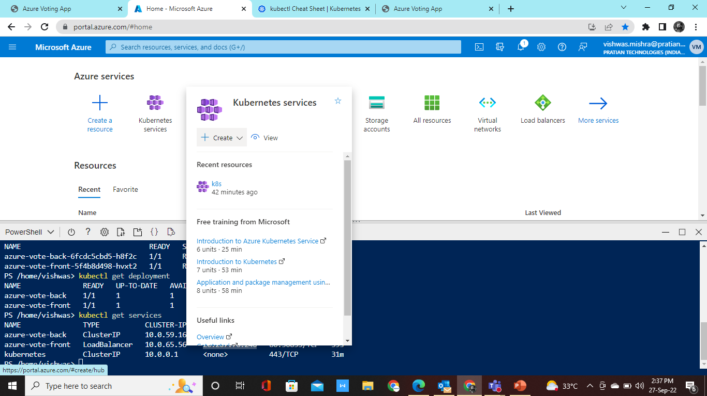
Goto azure platform and select Kubernetes services and click on create

Slide 3
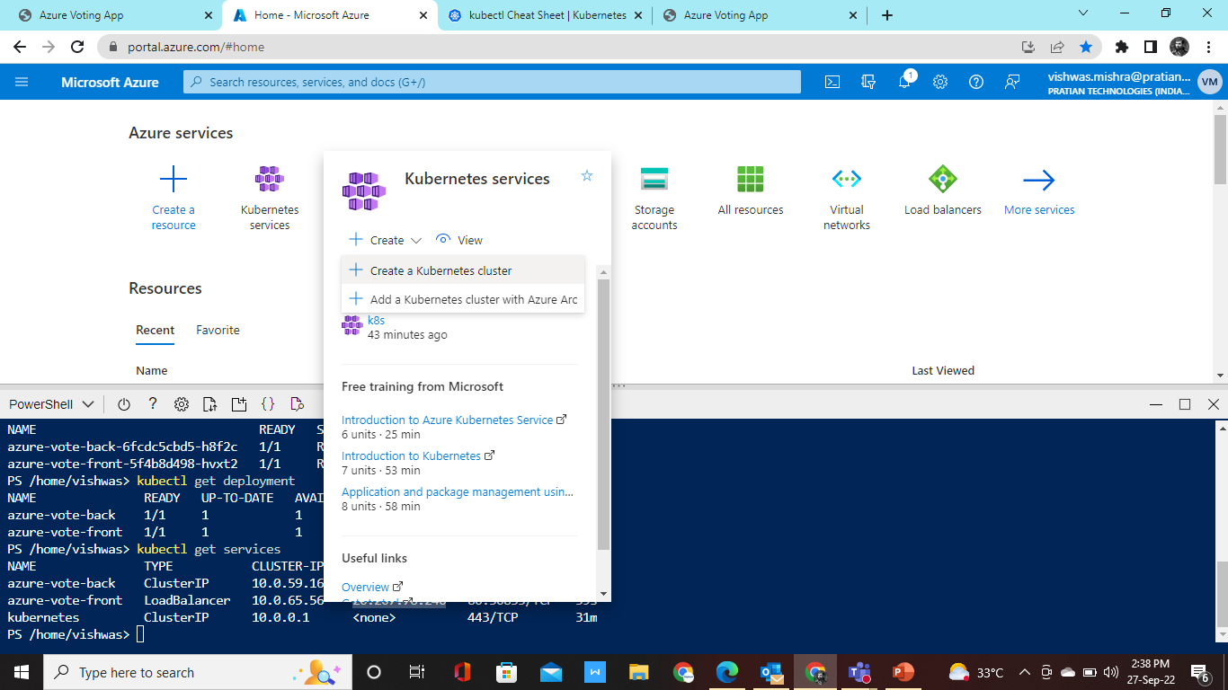
Then click on create the Kubernetes cluster

Slide 4
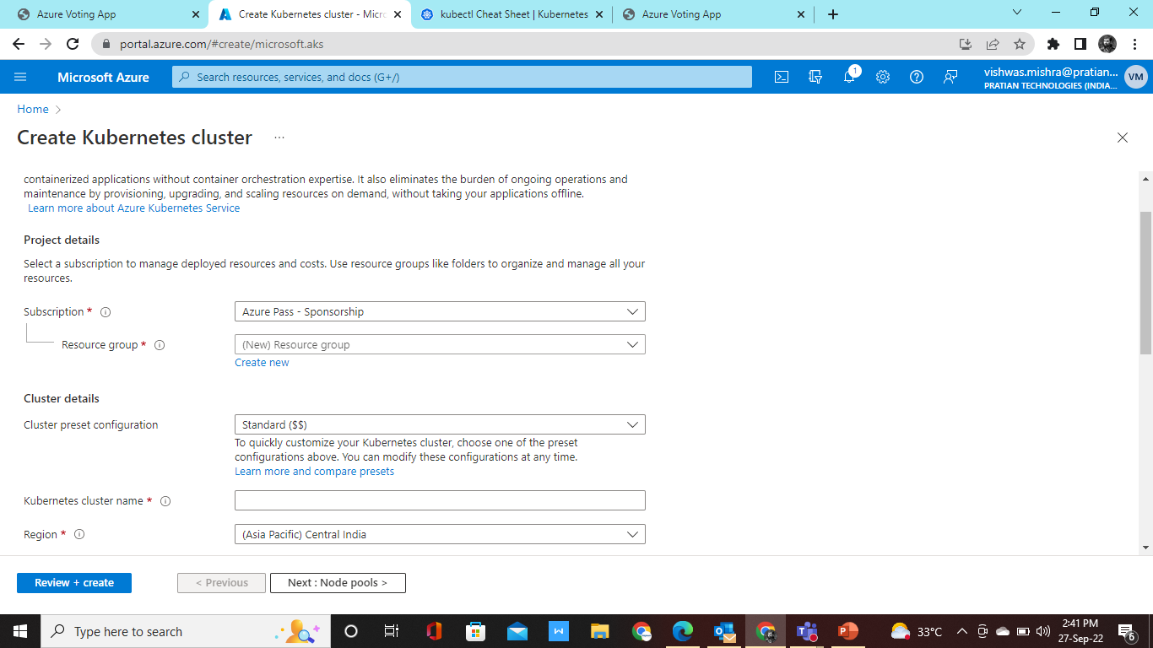
Then create resource group and cluster name as per you like

Slide 5
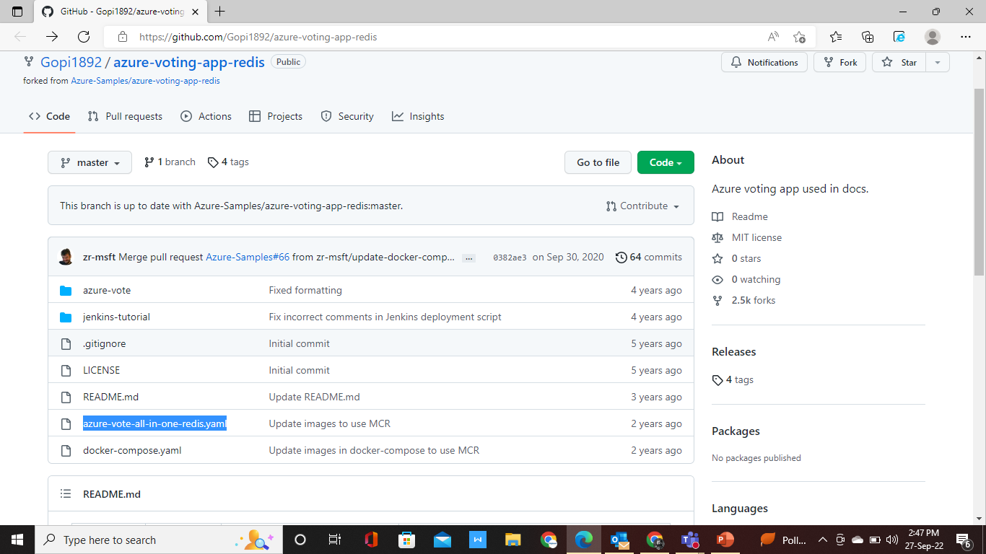
Once all settings are done for vm deployment
Copy the link below which trainer shared and open the code which is in .yaml format
https://github.com/Gopi1892/azure-voting-app-redis.git

Slide 6
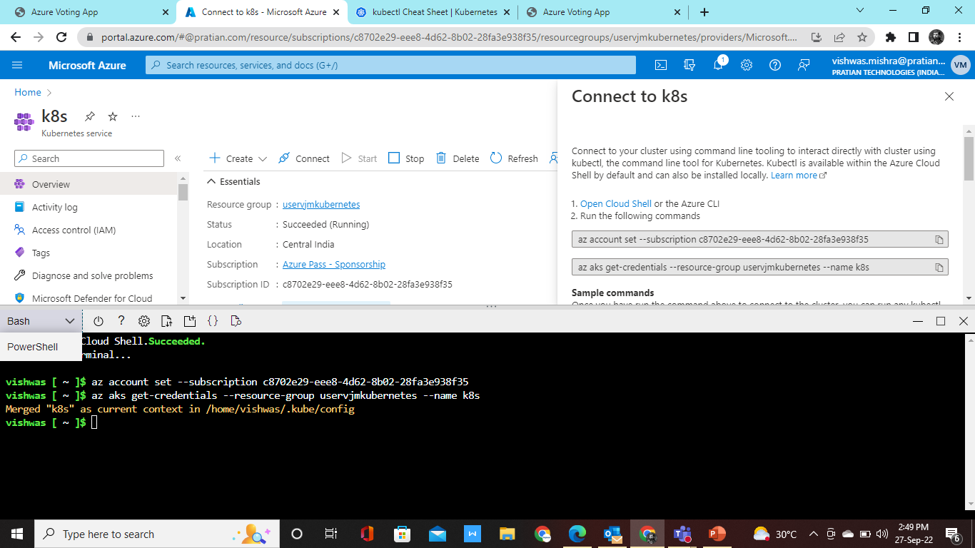
Once your vm is ready then connect with the terminal

Slide 7
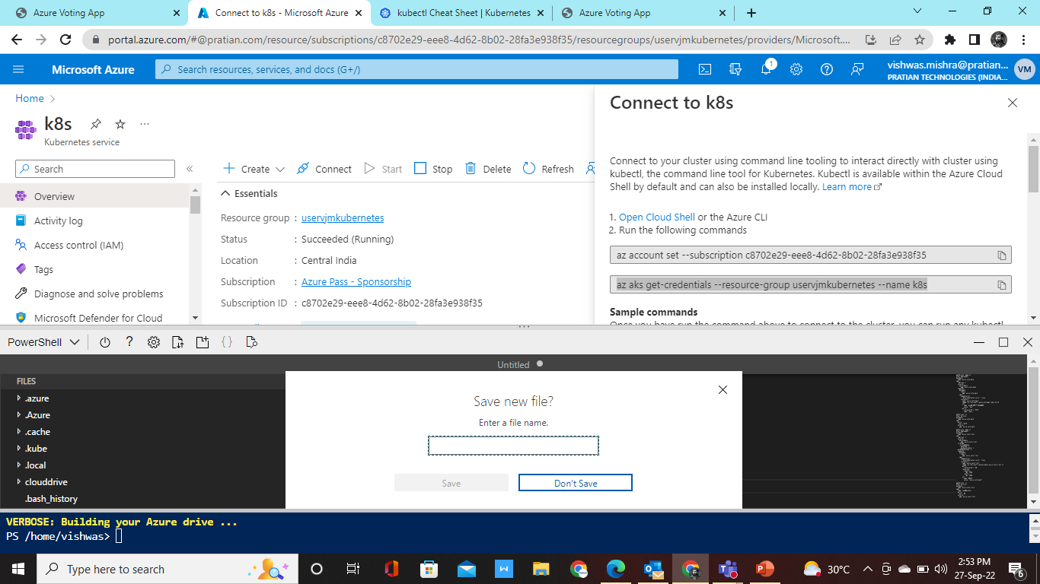
Copy the code from link and paste in editor and save the file as per you like.

Slide 8
Once file is save run command below are as follows
az account set --subscription c8702e29-eee8-4d62-8b02-28fa3e938f35
az aks get-credentials --resource-group uservjmkubernetes --name k8s
Kubectl –f (your file name)
Kubectl get pods
Kubectl get deployment
Kubectl get services

Slide 9
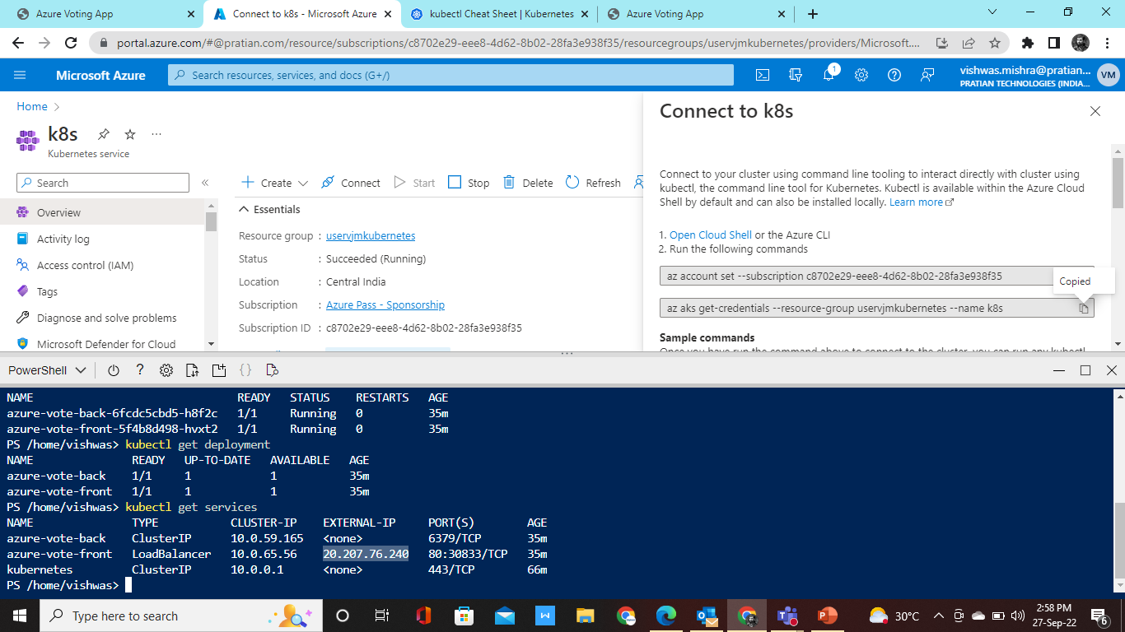
Once you run all command successfully in terminal copy the external ip address

Slide 10
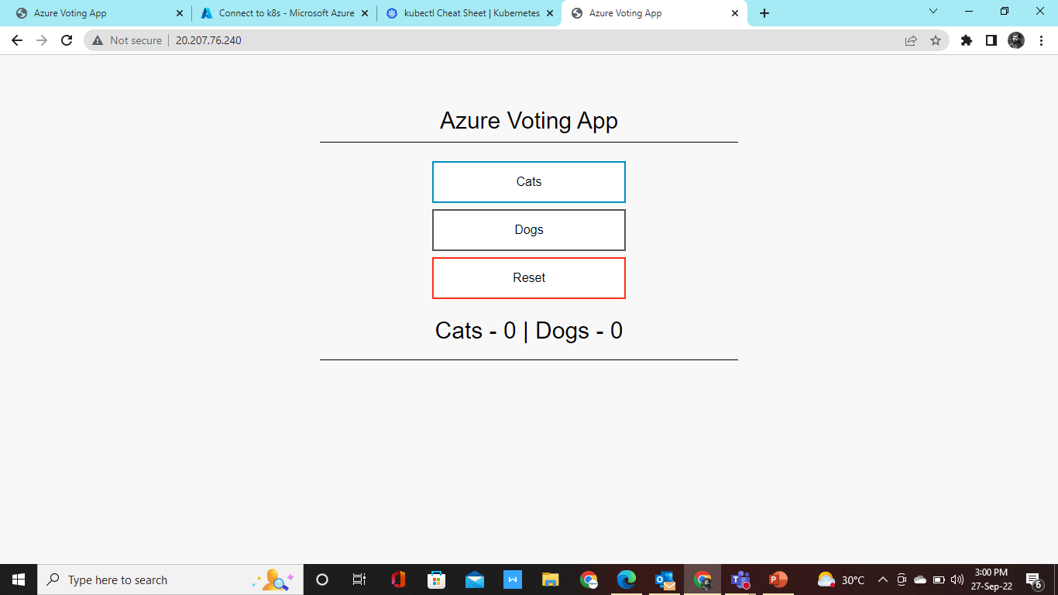
Paste the external ip on your browser url side. Will get the output of code below:

Slide 11
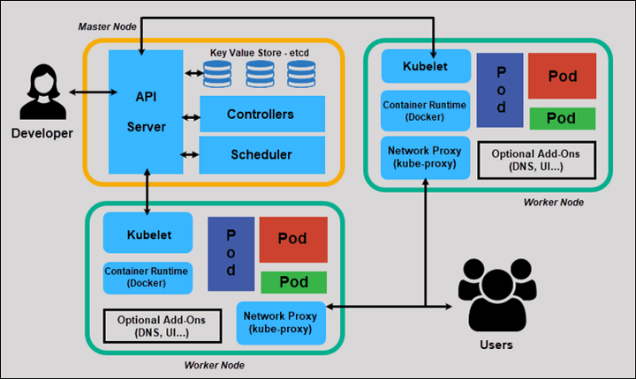
Kubernetes Architecture

Slide 12
Api Server
The API server is a centralized component where all the cluster components are communicated. Scheduler, controller manager and other worker node component communicate with the API server.

Slide 13
What is schedule and controller ?
Scheduler and controller manager request information to API server before taking any action. This API server exposes the Kubernetes API.
Scheduler is responsible for assigning your application to worker node. It will automatically detect which pod to place on which node based on the resource requirements, hardware constraints and other factors. It will smartly find out the optimum node which fulfills the requirements to run the application.
The Controller Manager maintains the cluster, it handles node failures, replicating components, maintaining the correct number of pods, etc. It constantly tries to keep system in desired state by comparing it with current state of system.

Slide 14
What Ectd will do?
Etcd is a data store that stores the cluster configuration.

Slide 15
What is worker node?
The Worker node are nothing but a virtual machine(VM’s) running in cloud or on-prem, a physical server running inside your data center.
Three basic components of the Worker Node(Data plane)
Kubelet
Kube-proxy
Container runtime

Slide 16
What is kubelet, kube-proxy and container run time , pods?
The Kubelet runs and manages the containers on node and it talks to API server.
The Kube-proxy load balances traffic between application components It is also called as service proxy which run on each node in the Kubernetes cluster.
Container runtime which runs the containers like Docker.
Pods are smallest unit of deployment in Kubernetes as container is smallest unit of deployment in Docker.

Slide 17

End of ppt

